Slide 1
Why Our Project Might be Doomed
Marko, with Sanil Nisha and Zach

Slide 2
Tkaczyszyn et. Al:
“The influence of the sounds of crying baby and the sounds of violence on haemodynamic parameters and autonomic status in young, healthy adults”
haemodynamic parameters include:
Heart Rate
Systolic BP
Diastolic BP

Slide 3
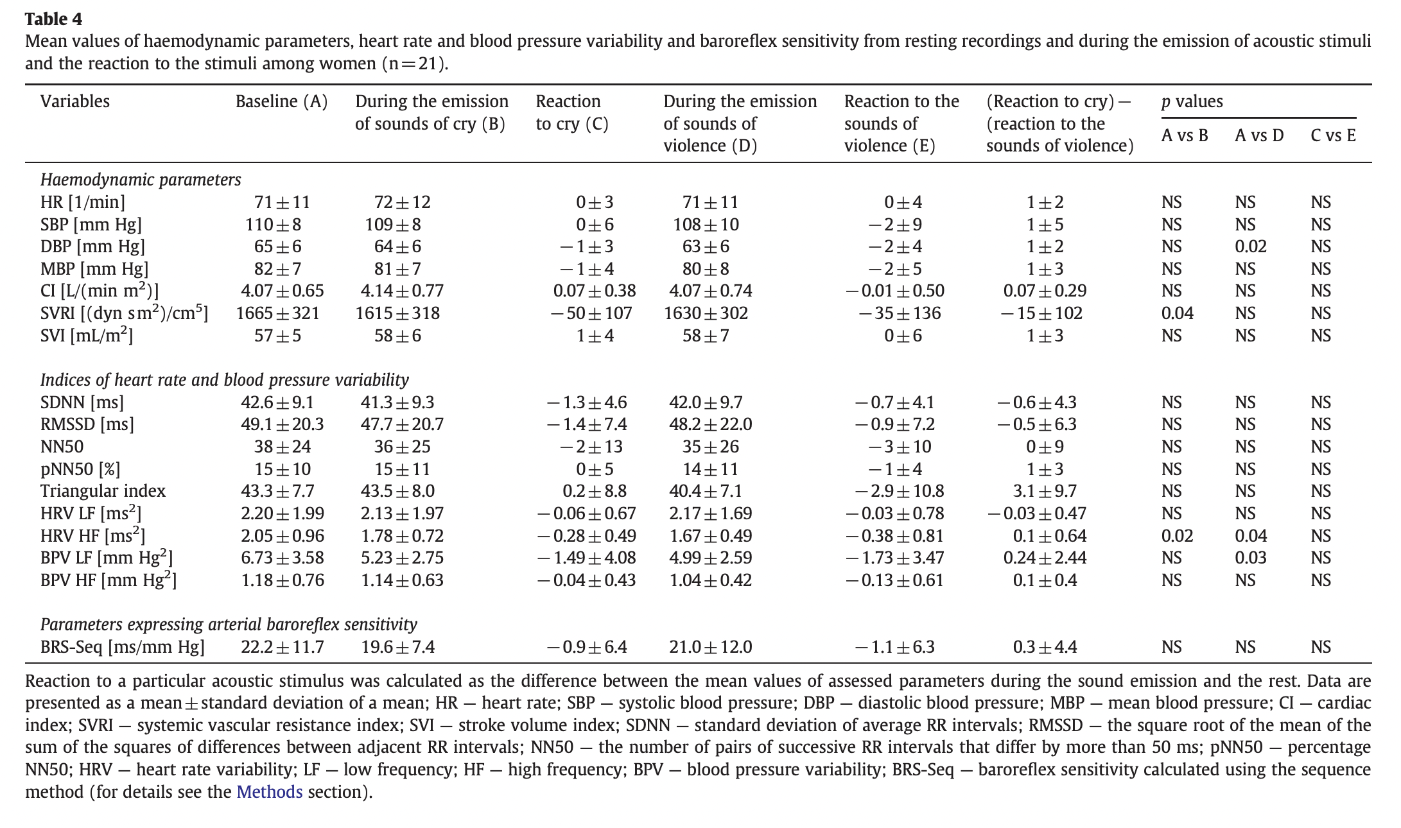
Tables 4 & 5:

Slide 4
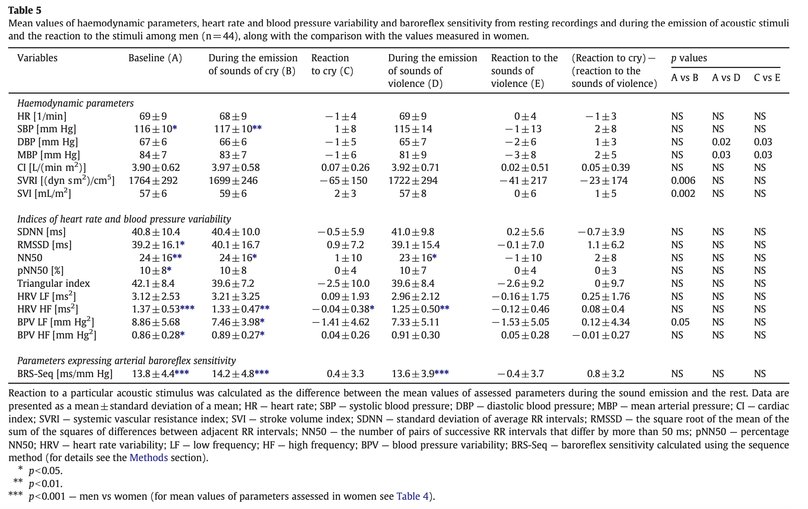
Tables 4 & 5:

Slide 5
Tkaczyszyn et. Al:
Michał Tkaczyszyn, Tomasz Olbrycht, Agata Makowska, Katarzyna Soboń, Bartłomiej Paleczny, Agnieszka Rydlewska, Ewa A. Jankowska,
The influence of the sounds of crying baby and the sounds of violence on haemodynamic parameters and autonomic status in young, healthy adults,
International Journal of Psychophysiology,
Volume 87, Issue 1,
2013,
Pages 52-59,
ISSN 0167-8760,
https://doi.org/10.1016/j.ijpsycho.2012.10.017.
(https://www.sciencedirect.com/science/article/pii/S0167876012006332)

